Slide 1
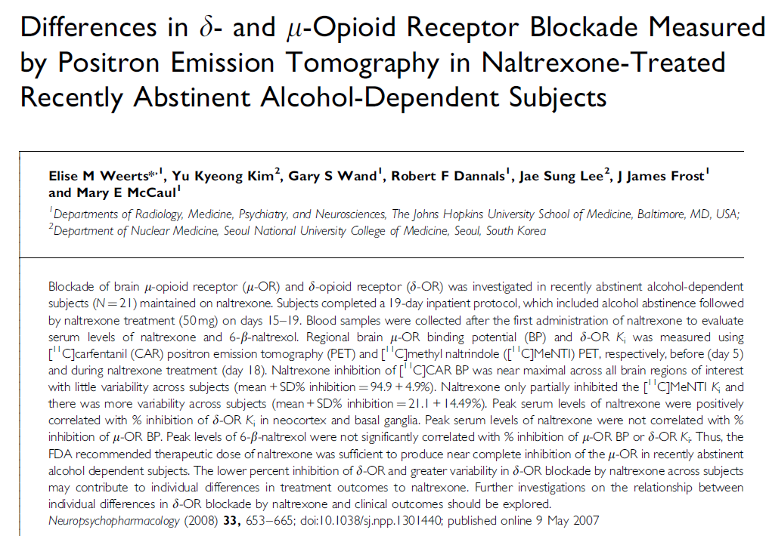

Slide 2
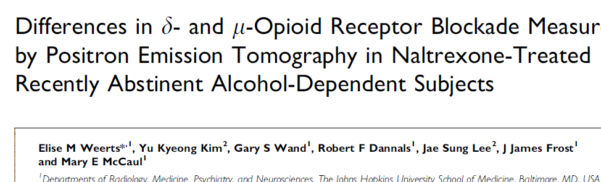
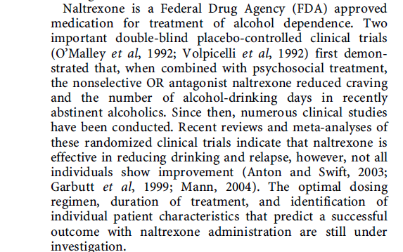

Slide 3
Regional brain MOR binding potential (BP) … using ¹¹C-carfentanil PET …before and during naltrexone treatment. Naltrexone inhibition of ¹¹C-carfentanil BP was near maximal across all brain regions of interest with little variability across subjects.

Slide 4
Study Design
1 5 10 15 18 19

Slide 5
Study Design
days of abstinence
1 5 10 15 18 19
Naltrexone
11C-MeNTI
11C-Carfentanil
bolus
bolus
11C-MeNTI
11C-Carfentanil
bolus
bolus

Slide 6
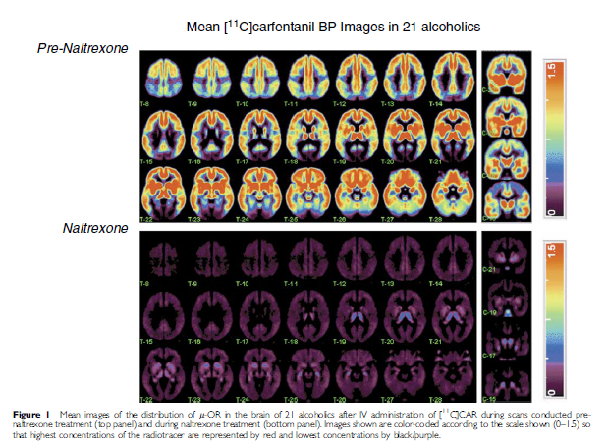
Occupancy of MOR by Naltrexone
Weerts et al., 2008

Slide 7
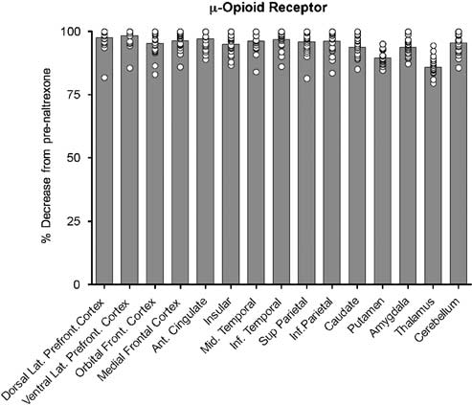
Clinical doses of NTX occupy ~100% of MOR in (recently abstinent) alcoholics
Individual Subjects
MOR = Mu Opiate Receptor
Weerts et al., 2008

Slide 8
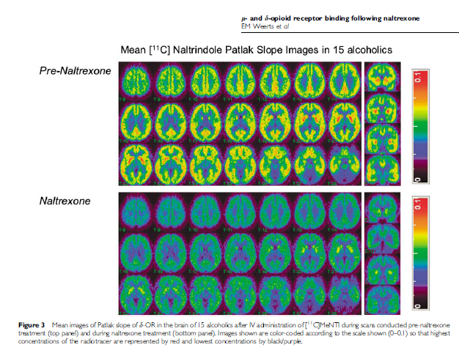
what are these images? not BP. why?

Slide 9
irreversible… means k4 = ?
so BP = ?
so is BP a good index to measure?
Instead, we measure
K1*k3
--------- …. what does this represent?
k2 + k3
what about this K1 * k3
--------
k2 + k3
think probability…

Slide 10
Hmmm…
If it ain’t MOR…and if it ain’t DOR… maybe its KOR?
But to test it, we need a kappa-specific ligand.

Slide 11

Conclusions

Slide 12
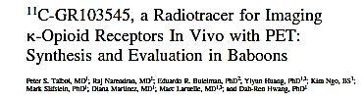
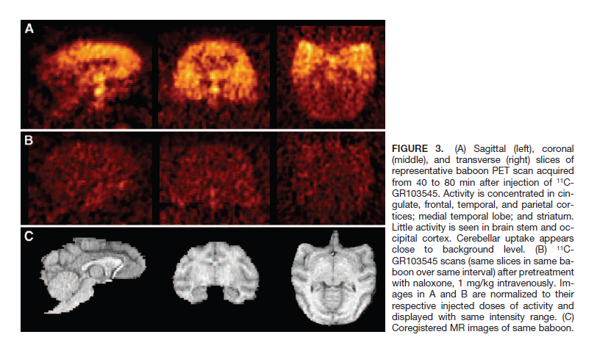
Talbot et al., JNM, 2005

Slide 13
Chemistry
Old process
Autoloop (FxC)
Radiochemical Yield:
  60 - 100 mCi (EOS)
  5-7%
High Specific Activity
  > 10 Ci/µmol @ EOS
Low mass limit (0.01 µg/kg)
Inject ~ 10 mCi
Specific Act. (n = 12)
0.96 ± 0.38 mCi/nmol
New process
Specific Act. (n = 30)
8.65 ± 3.14 mCi/nmol

Slide 14
Cool Image
MR
PET
Activity summed from 40-60 min post-injection from a male subject, normalized by injected dose.

Slide 15
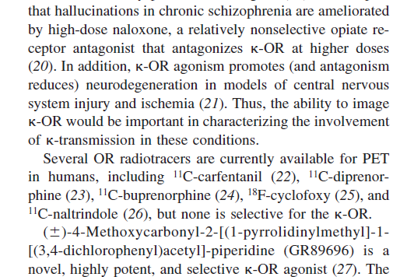
New Tracer for KOR
Several OR radiotracers are currently available for PET in humans including ¹¹C-carfentanil, ¹¹C-diprenorphine, ¹¹C-buprenorphine, ¹⁸F-cyclofoxy, and ¹¹C-naltrindole but none is selective for the KOR.

Slide 16
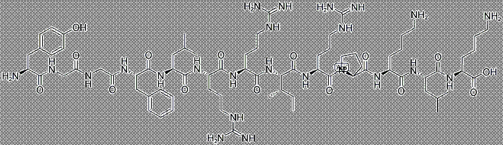
Tracer Information
KOR Antagonist
Tracer name: [¹¹C]PKAB
aka
LY2879788
Endogenous ligand:
Dynorphin

Slide 17
Chemistry
H₂, Ni
350 °C
¹¹CO₂
NH₃, Pt
950 °C
¹¹CH₄
Radiochemical Yield:
81.0 ± 30.6 mCi (n = 14)
Specific Activity (EOS):
1.18 ± 0.36 mCi/nmol (n = 14)
Precursor
H¹¹CN
dppf, Pd₂dba₃, KHCO₃
DMF, 80 °C, 5 min
Cyanation
NaOH, H₂O₂
80 °C, 5 min
Intermediate
Hydrolysis
[¹¹C]PKAB

Slide 18
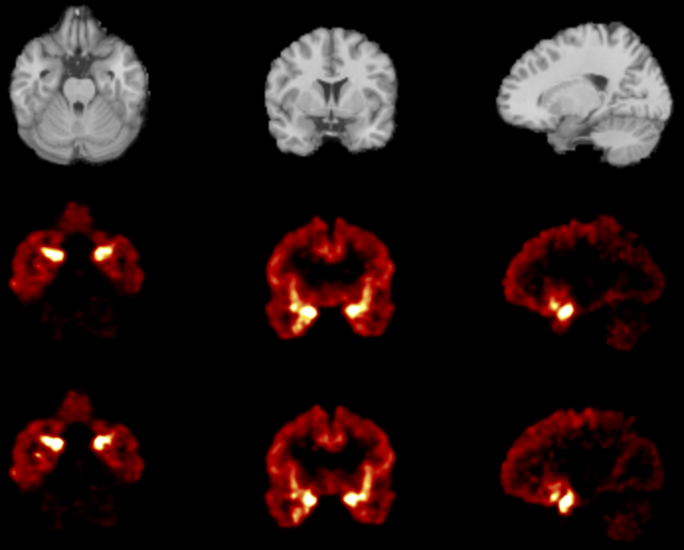

Cool Image
BP_{ND} images for a single subject computed using the SRTM2
method and data of 120 and 90 min post-injection.
MR
SRTM2_120
SRTM2_90

Slide 19
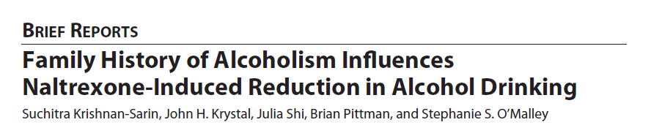
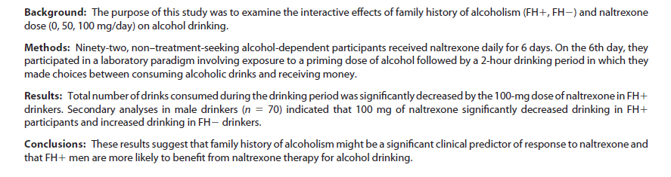

Slide 20
design
?
GCRC
?
3$ 3$ 3$ 3$

Slide 21
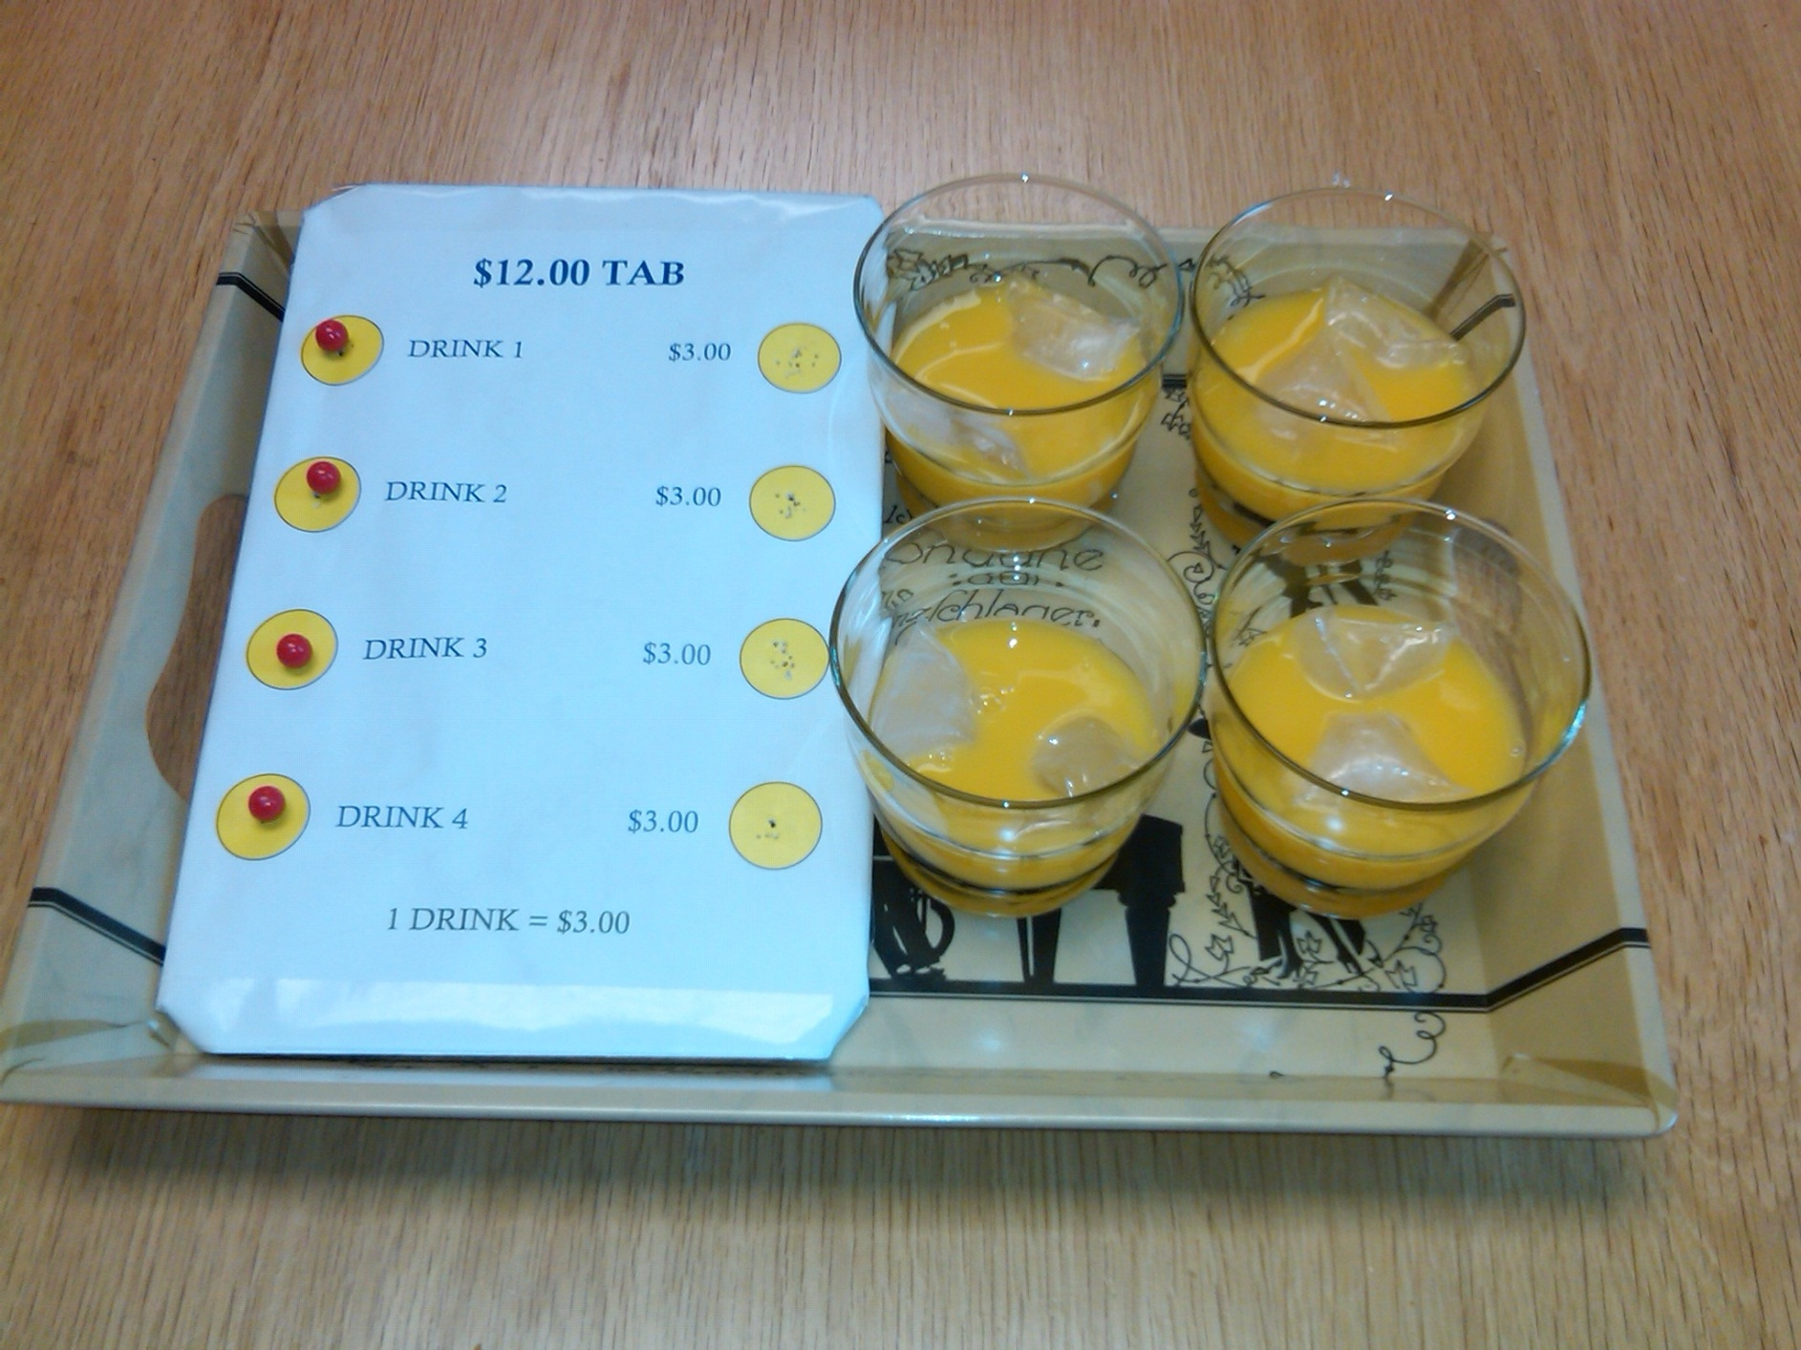

Slide 22
Alcohol Self-Administration Model (O’Malley, Krishnan-Sarin et al., 2002)
Day 0
Day 6
Day 7
Choice Block #1
5:00 pm
Choice Block #2
6:00 pm
7 pm
4 pm
Outpatient
Treatment
Alcohol Reactivity
craving
Ad-Lib Period
4 drinks per choice period (.015 g/dl)
$12 tab per choice period
Naltrexone
pretreatment
MET Intervention Discharge
Priming Drink
(.03 g/dl)

Slide 23
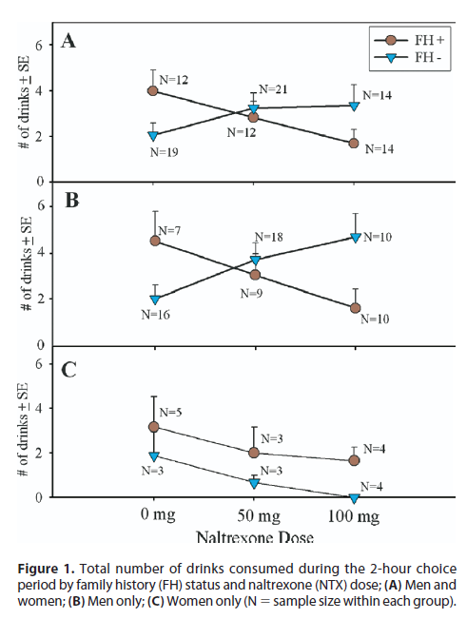

Slide 24
Get out some paper and a pen
you design a PET study to test the finding(s) in Krishnan-Sarin et al.

