Slide 1
Modeling Neurocircuitry using PET: Role of dopamine in cocaine abuse
Departments of Psychiatry¹ and Diagnostic Radiology²
Yale University School of Medicine
Wendol A. Williams, MD.
November 08, 2011

Slide 2
Dopamine System: why is it important??
Drugs of abuse → ↑↑ extracellular dopamine (DA) in limbic regions (e.g., nucleus accumbens NAc).
↑’d extracellular dopamine is associated with reinforcement
Drug-induced ↑ striatal DA associated w/ reports of reward
      High [Volkow et al., 1996a]
      Euphoria [Drevets et al., 2001]
Volkow et al., Neuropharm (2009) 56:3-8

Slide 3
Dopamine System: why is it important??
The firing rate of dopamine cells also encodes:
  Expectancy of reward [Volkow et al.,2003b]
  Saliency of given stimulus [Rolls et al.,1984; (and others, see ref. below)]
  Consolidation of memory connected to the drug
  In turn, will trigger DA cells w/ expectation of reward [Waelti et al., 2001]
Volkow et al., Neuropharm (2009) 56:3-8

Slide 4
Dopamine System: why is it important??
A new understanding of DA & reinforcement:
  via ↑DA, drugs are processed as salient stimuli
  associated with drug as expected reward [Waelti et al., 2001]
Thus, stimulus inherently motivates drug procurement regardless of whether a drug is consciously perceived as pleasurable.
Volkow et al., Neuropharm (2009) 56:3-8

Slide 5
Drug-induced DA increases in the human brain and reinforcement
Volkow et al. 2009, Neuropharm 56:3-8
  PET and specific D2 DA receptor ligands
  (e.g., [11C]raclopride, [18F]N-methylspiroperidol) study:
- drug modulation of DA
- reinforcement
  Reinforcement defined as:
- euphorigenicity effects
- high-inducement effects
- drug-liking effects
Volkow et al., Neuropharmacol 2009 56:3-8

Slide 6
Drug-induced DA increases in the human brain and reinforcement
Volkow et al. 2009, Neuropharm 56:3-8
  IV stimulant MP (0.5 mg/kg) is cocaine-like
- ↑ DA via DAT blockade
  IV stimulant Amphet (0.3 mg/kg) is methamphet-like
    - ↑ DA via DA release in terminals
  Both IV stimulants ⇒ ↑ extracellular DA in striatum
- euphoria and high-inducement effects
On the other hand:
  PO MP (0.75 – 1.0 mg/kg) ⇒ ↑ DA, but is not reinforcing
Volkow et al., Neuropharmacol 2009 56:3-8

Slide 7
Drug-induced DA increases in the human brain and reinforcement
Volkow et al. 2009, Neuropharm 56:3-8
  Speed of Brain Entry is key factor
  IV stimulant administration ⇒ fast ∆ DA phasic DA firing ↑↑ DA flux (30 hz)
  PO stimulant administration ⇒ slow ∆ DA tonic DA firing DA_{SS} (5 hz)
Empirically:
  Slow speed of entry ⇒ ↑ DA, but is not reinforcing
Volkow et al., Neuropharmacol 2009 56:3-8

Slide 8
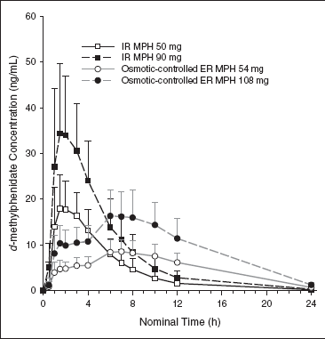
Drug-induced DA increases in the human brain and reinforcement
Volkow et al. 2009, Neuropharm 56:3-8
Figure 1. Mean (SD) plasma concentration time profile of d-methylphenidate following single doses of osmotic-controlled extended-release (ER) methylphenidate (MPH) 54 mg and 108 mg, as well as immediate-release (IR) MPH 50 mg and 90 mg.
Parasrampuria et al., J Clin Pharmacol. 2007 47:1476-88

Slide 9
Study I
Effects of route of administration on cocaine induced dopamine transporter blockade in the human brain
Volkow et al.2000 Life Sci, 67:1507-15

Slide 10
Route of cocaine administration and DAT blockade
Volkow et al. 2009, Neuropharm 56:3-8
Compared DAT blockade induced by cocaine as a function of iv-smoked-intranasal route of administration in cocaine abusers using PET and [¹¹C]cocaine as a DAT ligand
Volkow et al.2000 Life Sci, 67:1507-15

Slide 11
Methods
Study Participants:
Thirty-two cocaine abusers (24M & 8F, 37 yr w/ 13 yr education)
  Persistent use of cocaine for at least the prior 6-months, 2 gm/wk
  Experience w/ iv and smoked cocaine
  No current or past psychiatric or neurological disease
  No significant medical illness
  Cocaine use on average was 12±15 yr
  Amount used was 5±7 gram week
  Last use 5±8 days prior to study
Volkow et al.2000 Life Sci, 67:1507-15

Slide 12
Study Design
Drug dosage:
- smoked 25 and 50 mg;
    - intranasal 48 and 96 μg;
    - iv 0.3 and 0.6 mg/kg
Behavioral measures:
- self reports of “high” to estimate reinforcing efficacy of cocaine
PET Scans:
- up to 4 scans over 2d period
- scan order: placebo scan
- then, active condition scan, 2 hr after initial placebo scan, and cocaine administration
Volkow et al.2000 Life Sci, 67:1507-15

Slide 13
Study Design
Study Design
Drug administration:
- iv cocaine over 30 sec, then [¹¹C]cocaine co-delivered as bolus
  - smoked: placebo (warm air) or glass pipe inhalation, inhaled as normal, then [¹¹C]cocaine injected immediately after exhalation
  - intranasal: insufflation w/ 5 cm straw over 30 sec, [¹¹C]cocaine injected after 30 min.
Volkow et al.2000 Life Sci, 67:1507-15

Slide 14
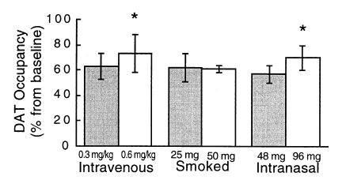
Results
Figure 1. DAT occupancy as a function of dose and route. At low doses, DAT occupancy did not differ across routes of administration. Blockade was significantly greater for the large than the low dose for intravenous and intranasal cocaine but not for smoked cocaine. *Comparisons between the high and low dose for a given route (p <0.05).
Volkow et al.2000 Life Sci, 67:1507-15

Slide 15
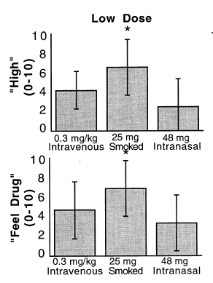
Results
Figure 2. All doses and routes of cocaine significantly increased ratings of “high” and “feel drug”. Post hoc t-tests showed that for the low doses, which gave equivalent plasma levels and equivalent levels of DAT blockade for routes (iv 63±10%,smoked 62±11%, and intranasal 57±7%), self reports of “high” were significantly more intense for smoked than for intranasal cocaine (p<0.05) and there was a trend for a more intense “high” for iv than for smoked cocaine.
Volkow et al.2000 Life Sci, 67:1507-15

Slide 16
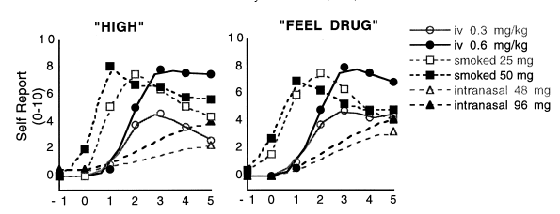
Results
Figure 4. The time to reach peak ratings of “high” and “feel drug” was significantly faster for smoked (“high” 1.4±0.5 min; “feel drug” 1.3±0.4 min) than for iv (“high” 3.1±0.9 min; “feel drug” 3.0±1), which was faster than intranasal cocaine (“high” 14.6±8 min; “feel drug” 12.0±7).
Volkow et al.2000 Life Sci, 67:1507-15

Slide 17
Summary
Differences in reinforcing effects of cocaine as a function of the route of administration, are most likely dependent on drug pharmacokinetics, and not solely on differences in the degree of DAT blockade.
Volkow et al.2000 Life Sci, 67:1507-15

Slide 18
Evidence of DA Involvement in Substance Use Disorders

Slide 19
Role of DA in long-term effects of drugs of abuse on DA in human brain
Volkow et al. 2009, Neuropharm 56:3-8
  Question:
  Since synaptic increase in DA occurs in both addicted and non-addicted individuals, why do some people develop a compulsive drive to take drugs and others do not?

Slide 20
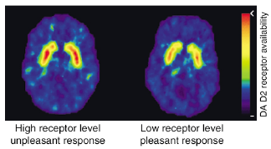
Role of DA in long-term effects of drugs of abuse on DA in human brain
Volkow et al. 2009, Neuropharm 56:3-8
  The answer may have to do with repeated perturbation of the DA system in vulnerable individuals
Figure 3. Subjects with low numbers of D2 receptors may be at higher risk for abusing stimulant drugs than those with high numbers of D2 receptors, in whom drugs such as methylphenidate may produce unpleasant effects that limit its abuse.
Volkow et al., Neuropharmacol 2009 56:3-8

Slide 21
Study II
Amphetamine-induced dopamine release: markedly blunted in cocaine dependence and predictive of the choice to self-administer cocaine
Martinez et al.2007 Am J Psychiatry,164:622-629

Slide 22
Methods
STUDY PARTICIPANTS:
24 cocaine dependent (CD)
24 matched healthy controls (HC)
No DSM-IV Axis I diagnoses
2-wk supervised abstinence, Inpatient clinical research unit
HCs participated in study as outpatients
Nicotine permitted in both groups
Martinez et al.2007 Am J Psychiatry,164:622-629

Slide 23
Methods
SCANS:
[¹¹C]raclopride scans:
baseline condition
iv amphetamine (0.3 mg/kg)
COCAINE SELF-ADMINISTRATION:
self-administer cocaine dose
Coc priming dose
receive monetary reward
Choice
Martinez et al.2007 Am J Psychiatry,164:622-629

Slide 24
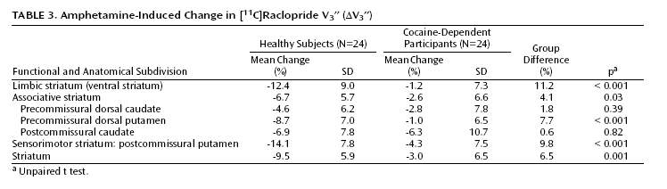
Results
CD was associated with a marked reduction in amphetamine-induced DA release in:
1) limbic striatum: -1.2% (CDs) vs. -12.4% (HCs)
2) Associative Striatum: -2.6% (CDs) vs. -6.7% (HCs)
3) Sensorimotor striatum: -4.3% (CDs) vs. -14.1% (HCs)
Martinez et al.2007 Am J Psychiatry,164:622-629

Slide 25
Results
Association between the choice to self-administer cocaine and change in [¹¹C]raclopride V3’’ following amphetamine administration in cocaine-dependent subjects.
Significant negative correlation seen in ventral striatum, → CDs with lowest DA transmission were more likely to choose cocaine over an alternative reinforcer.
Martinez et al.2007 Am J Psychiatry,164:622-629

Slide 26
Summary
    Blunted DA transmission in ventral striatum and anterior caudate was predictive of choice of cocaine over money
    Cocaine-dependent subjects who are most vulnerable to relapse are those with the lowest presynaptic DA function.
Martinez et al.2007 Am J Psychiatry,164:622-629

Slide 27
Study III
Elevated striatal dopamine transporters during acute cocaine abstinence as measured by [¹²³I]β-CIT SPECT
Malison et al. (1998) Am J Psychiatry 1558:832-34

Slide 28
Methods
STUDY PARTICIPANTS:
28 cocaine dependent (CD), heavy, frequent iv, crack use
24 matched healthy controls (HC)
No DSM-IV Axis I diagnoses
96-hr supervised abstinence, locked inpatient clinical research unit
HCs were studied as outpatients
Malison et al. (1998) Am J Psychiatry 1558:832-34

Slide 29
Methods
Behavioral Assessments:
Cocaine Craving Scale
Hamilton Depression Rating Scale
Hamilton Anxiety Rating Scale
Malison et al. (1998) Am J Psychiatry 1558:832-34

Slide 30
Methods
Scan Protocol:
Subjects received an injection of [123I]β-CIT, followed by
SPECT scan, 24 hr later
Outcome measure: V3”, specific/non-displaceable binding = striatum-occipital/occipital
Malison et al. (1998) Am J Psychiatry 1558:832-34

Slide 31
Results
Found a modest 20%, but robust increase in V3’’ in CDs vs. HCs: 9.5 ± 2.1 vs. 8.1 ± 1.5; (p<0.008).
Levels of depression were significantly correlated with [¹²³I]β-CIT binding in CDs (r=-0.50, df=26, p=0.02).
Malison et al. (1998) Am J Psychiatry 1558:832-34

Slide 32
Summary
More work to determine whether:
a) increases in cocaine binding sites reflect a pre-morbid, predisposing trait in susceptible individuals; or,
b) whether dopamine transporter elevations are secondary to chronic DA reuptake blockade by cocaine.
Malison et al. (1998) Am J Psychiatry 1558:832-34

Slide 33
Summary
Volkow addresses this point indirectly and may offer a counter-point by observing that:
a) ↓ inD2 DA_{R} B_{max} might reflect decreased receptor and/or increased DA release in striatum; but,
b) since CDs given MP iv. show blunted ↓s in specific binding (i.e., decreased DA release), there may be both a reduction in DA release and in D2 receptor density.
Malison et al. (1998) Am J Psychiatry 1558:832-34

Slide 34
Role of DA in long-term effects of drugs of abuse on DA in human brain
Volkow et al. 2009, Neuropharm 56:3-8
Figure 1. (A) Normalized volume of distribution of [11C]raclopride binding in the striatum of cocaine and methamphetamine abusers and non-abusing comparison subjects. (B) Correlation of DA receptor availability (B_{max}/K_{d}) in the striatum with measures of metabolic activity in the orbitofrontal cortex (OFC) in cocaine (closed diamonds) and methamphetamine (open diamonds) abusers.
Volkow et al., Neuropharmacol 2009 56:3-8

Slide 35
Role of DA in long-term effects of drugs of abuse on DA in human brain
Volkow et al. 2009, Neuropharm 56:3-8
  OFC, CG, and DLPFC
  - inhibitory control
  - emotional processing
  Abnormal DA in addicts →
  - loss of control over drug use,
  - poor emotional self-regulation

Slide 36
Role of DA in long-term effects of drugs of abuse on DA in human brain
Volkow et al. 2009, Neuropharm 56:3-8
  Also ties in with craving and cue-activation:
  ↓ in D2 DA_{R} availability in ventral striatum is associated with alcohol craving severity; and,
  - greater cue-activation of medial prefrontal cortex and anterior CG (via fMRI, Heinz et al, 2004).

Slide 37
Study IV
Increased occupancy of dopamine receptors in human striatum during cue-elicited cocaine craving
Wong et al. (2006) Neuropsychopharm. 31:2716-27

Slide 38
Role of DA in long-term effects of drugs of abuse on DA in human brain
Volkow et al. 2009, Neuropharm 56:3-8
  Also ties in with craving and cue-activation:
  ↓ in D2 DA_{R} availability in ventral striatum is associated with alcohol craving severity; and,
  - greater cue-activation of medial prefrontal cortex and anterior CG (via fMRI, Heinz et al, 2004).

Slide 39
Background
    Hypotheses tested were that :
      1)cocaine abusers who report increased cocaine craving in response to cocaine-related cues (‘cravers’) have a greater DAR occupancy than abusers who do not report increased craving (‘non-cravers’); and,
      2) the change of DAR occupancy correlates with the intensity of craving for cocaine .
Wong et al. (2006) Neuropsychopharm. 31:2716-27

Slide 40
Methods
STUDY PARTICIPANTS:
19 subjects (16M;3F) met criteria for stimulant abuse
Reported usage at least 2x/wk for mean = 13 yrs
No DSM-IV Axis I diagnoses
48-hr supervised abstinence, locked inpatient clinical research unit
No nicotine or caffeine at least 6 hr prior to scan
Wong et al. (2006) Neuropsychopharm. 31:2716-27

Slide 41
Methods
SCANS:
- [¹¹C]raclopride, injected at the beginning of each of two 90-min PET scans, separated by 2-hr.
- First scan done while exposed to 10-min neutral cues videotapes and a 45-min audiotape of pleasurable experiences from cocaine
- subjective baseline ratings collected 10 – 15 min before scan
- 10 min before scan session-appropriate script read
- ratings done throughout scan on specific schedule
Wong et al. (2006) Neuropsychopharm. 31:2716-27

Slide 42
Methods
SUBJECT GROUPING:
- Mean craving score for responses during the neutral videotape was calculated.
  - Change in craving = mean craving (videotape) – mean craving score during neutral videotape scan
  - Calculated the craving score as a continuous variable for testing correlations with PET parameters
  Larger mean score during craving video than with neutral cues = (+)“craver”.
Wong et al. (2006) Neuropsychopharm. 31:2716-27

Slide 43
Results
The change of DAR occupancy values for Lt. and Rt. anterior putamen and the individual craving scores were analyzed.
Lt. anterior putamen showed a significant correlation (r=0.76, p<0.0001) between the change in DAR occupancy and cocaine craving scores.
Comparison of Rt. vs. Lt. anterior putamen showed that relationship between DAR occupancy and craving score was significantly stronger, Lt anterior putamen vs. Rt (p<0.005).
Wong et al. (2006) Neuropsychopharm. 31:2716-27

Slide 44
Results
Wong et al. (2006) Neuropsychopharm. 31:2716-27

Slide 45
Limitations
1) Rating craving
2) Scan order
3) Diurnal dopamine fluctuation
4) nicotine (cigarette smoking)
5) Statistical power to detect laterality
Wong et al. (2006) Neuropsychopharm. 31:2716-27

Slide 46
Summary
1) Changes in DAR occupancy can provide a surrogate marker for drug craving
2) Technique may be useful in studying other motivational states linked to dopamine
3) Data demonstrates the importance of the dorsal striatal dopamine system in automated habitual behavior.
Wong et al. (2006) Neuropsychopharm. 31:2716-27

